Slide 1
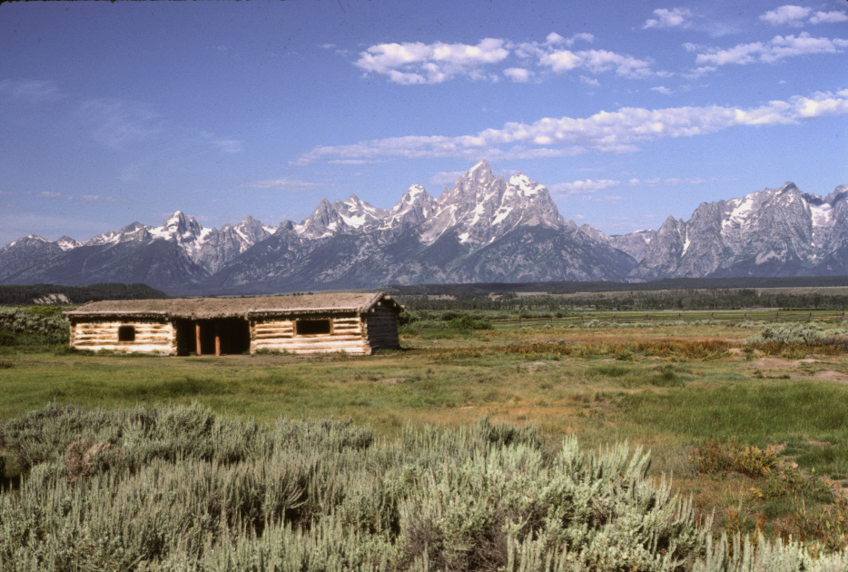
Home, home on the Basin and Range... Where the continent stretches all day….
Notes:
Behold the Grand Tetons! They’re about as Basin and Rangey as you can get!

Slide 2
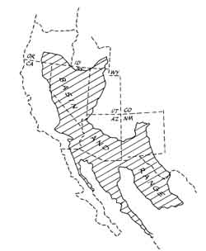
Grand Tetons
Notes:
This is a little surprising, because geographically they barely qualify as Basin and Range. Being located at the farthest northeast tip of the province, however, is exactly what made them so quintessentially Basin and Rangey.

Slide 3
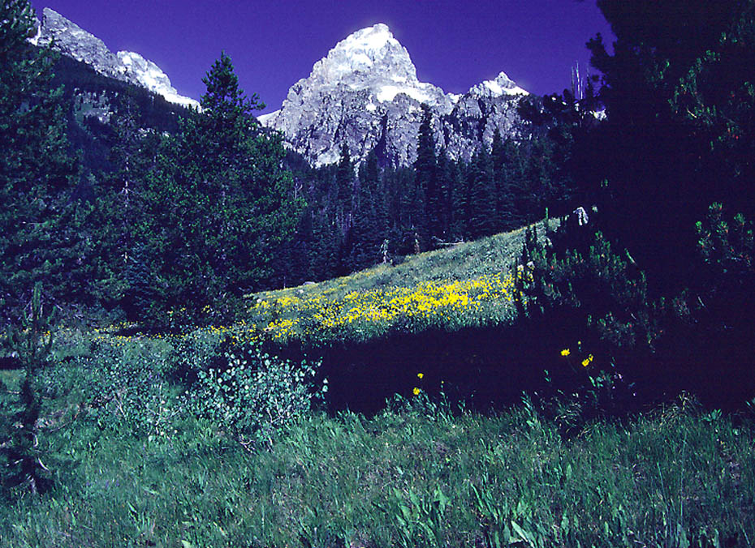
Notes:
That northerly position made them vulnerable to glaciation, which eroded the peaks into these majestic pyramidal forms, …

Slide 4
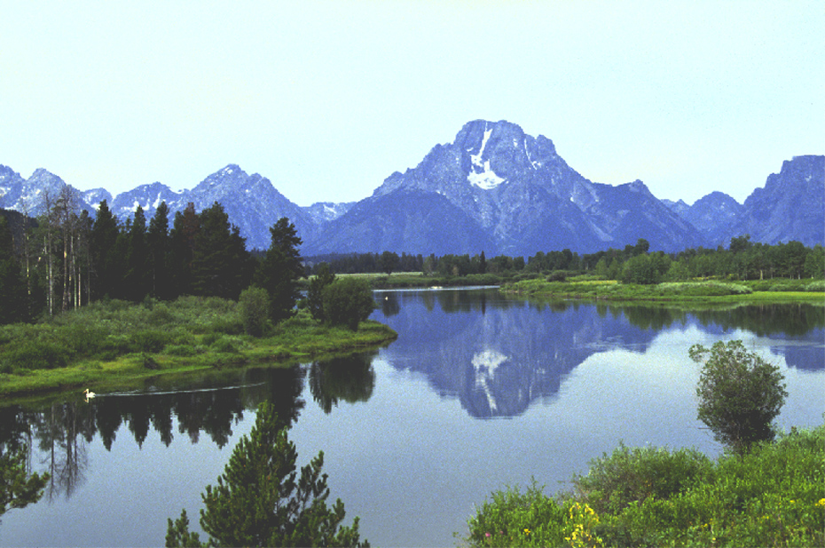
Notes:
… and filled the basins with flat-lying glacially-derived sediments.

Slide 5
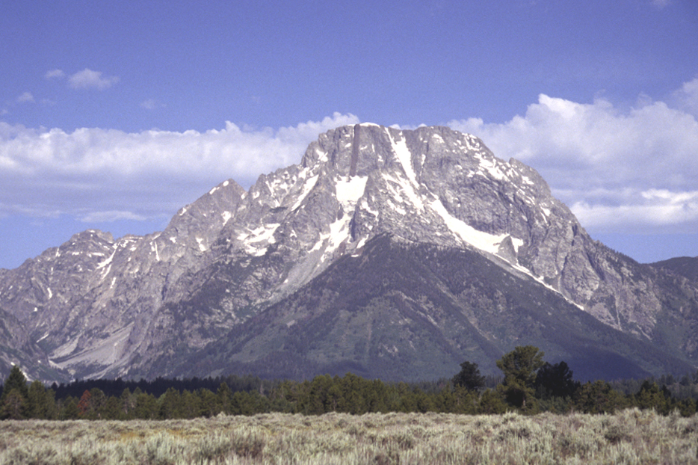
Notes:
Glaciation contributes to that most striking feature of the Grand Tetons, the abrupt juxtaposition of a towering range against a broad flat valley, but it’s only half the story.

Slide 6
Grand Tetons
Notes:
Being positioned at edge of the Basin and Range also contributes to the youth of the Grand Tetons.

Slide 7
Asymmetrical half-grabens
Symmetrical basins
Notes:
Youth implies a relatively small amount of extension, which as you will remember from the previous overview of the Basin and Range province, causes the fault-bounded sides of the basins to be especially steep.

Slide 8
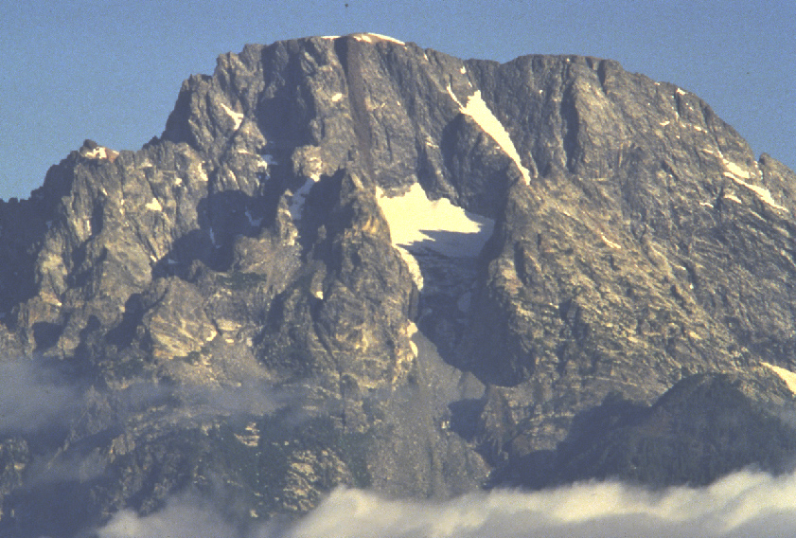
Notes:
But there’s more than just glaciation and youthful extension to the geological story. Lets zoom in on Mount Moran.

Slide 9
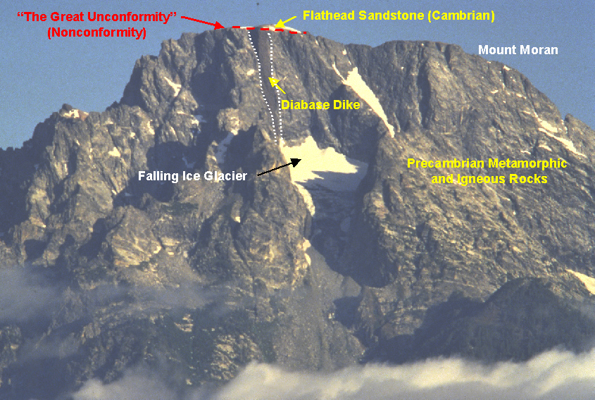
Notes:
The bulk of the range is comprised of Precambrian metamorphic and igneous rocks including several diabase dikes. Resting nonconformably above them lie a sequence of Paleozoic sedimentary rocks. You do remember what a nonconformity was don’t you?

Slide 10
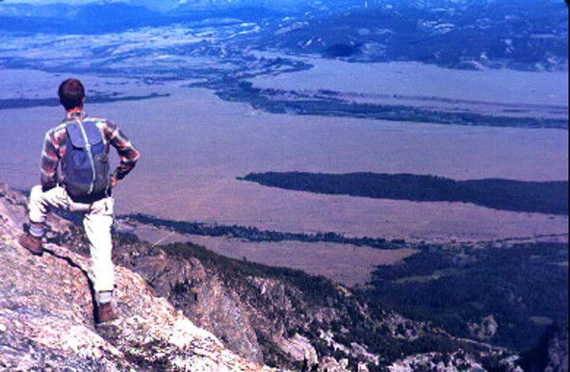
Gneiss view!
Notes:
If you climb up to the top of the range your reward is both a nice view and a view of gneiss.

Slide 11
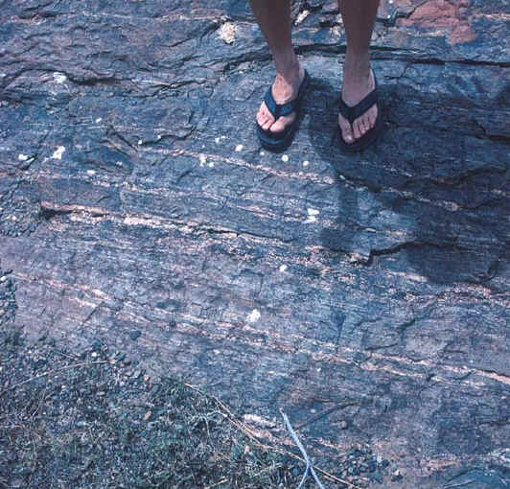
Notes:
Gneiss is a high-grade metamorphic rock characterized compositional banding …

Slide 12
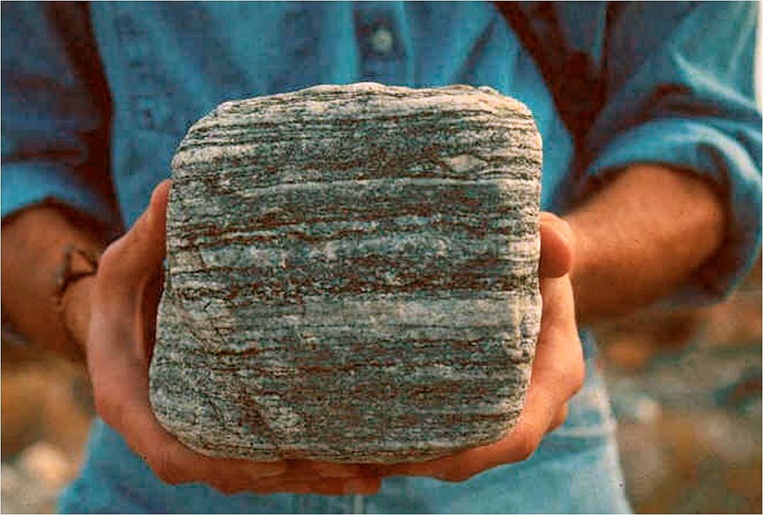
Notes:
… and coarse, inter-grown crystals.

Slide 13
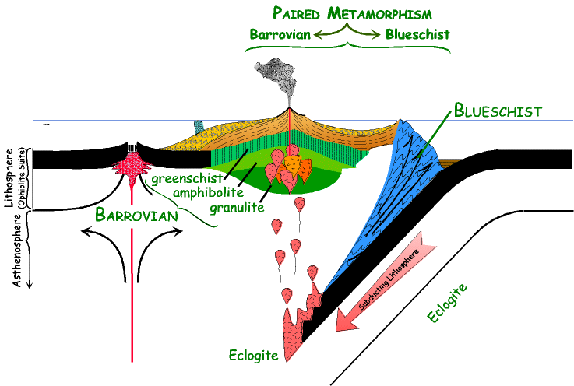
Notes:
It is typically formed in the deepest roots of mountain ranges by granulite-grade Barrovian metamorphism.

Slide 14
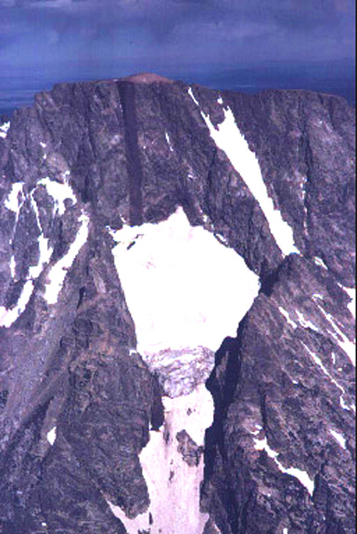
sandstone
Notes:
Here we see the Cambrian Flathead sandstone nonconformably resting atop Mt Moran and a vertical, Proterozoic diabase dike.

Slide 15
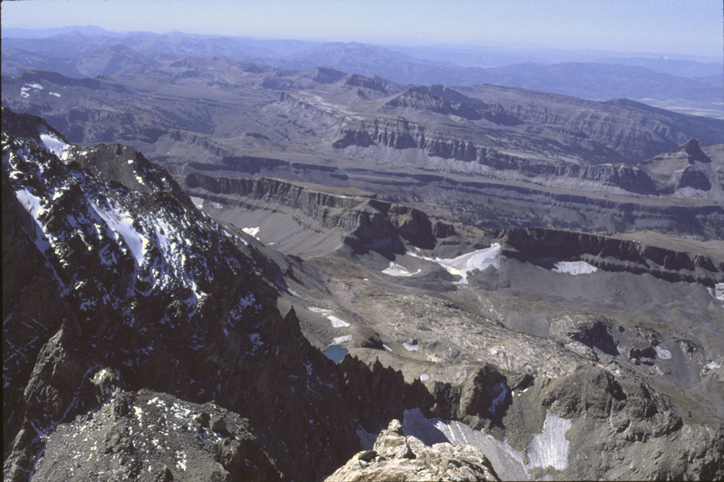
Cambrian sedimentary rocks (Flathead Sandstone)
Notes:
The Flathead sandstone is part of a gently tilted sequence of lower Paleozoic sedimentary rocks on western part of Teton Range.

Slide 16
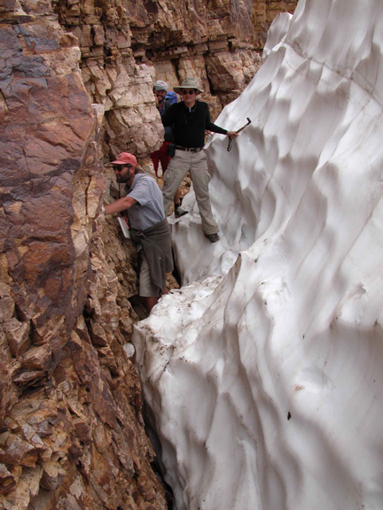
Notes:
The Flathead Sandstone is middle Cambrian in age and represents the sandy shoreline of a marine transgression sequence. If you look closely you can see that the freshly exposed sandstone is fairly light in color, indicating that it is quartz-rich. Considering that this quartz sandstone rests nonconformably on the gneiss …

Slide 17
What tectonic situation does this assemblage of rocks suggest?
Notes:
… what tectonic situation does this assemblage of rocks suggest? Come on now; think about the Wilson Cycle…

Slide 18
quartz sandstone
granite & gneiss
Notes:
Remember this diagram? If you do then you will also remember it as a DCM – a divergent continental margin. So this part of North America was near the shoreline of a DCM during the Cambrian.

Slide 19
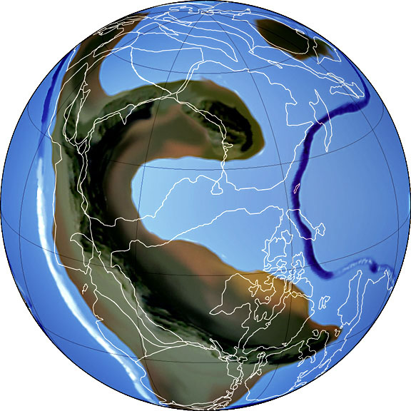
RODINIA
~750 Ma
Notes:
That should make sense if you recall that the break-up of Rodinia and Pannotia included the rifting of North America from Australia and Antarctica,

Slide 20
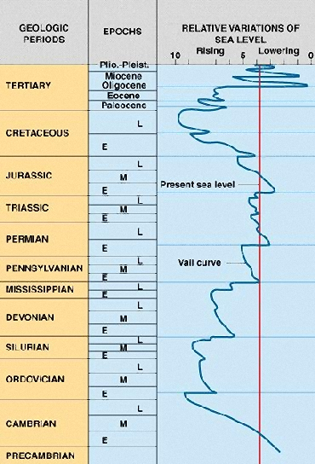
Rapid Sea Floor Spreading
Sediment Transfer into Oceans
Pangaea
Rapid Sea Floor Spreading
Sediment Transfer into Oceans
Pannotia
Notes:
… and that supercontinent rifting is always followed by a period of prolonged sea-level rise.

Slide 21
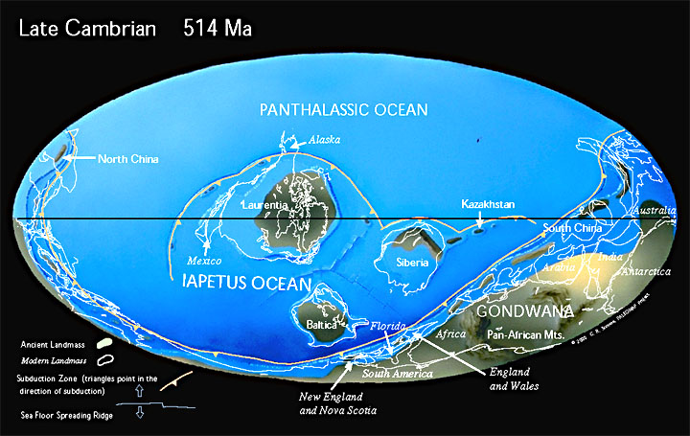
Grand Tetons
Notes:
See how it all fits? The area of the Grand Tetons was awash in shallow seas during the Cambrian.

Slide 22
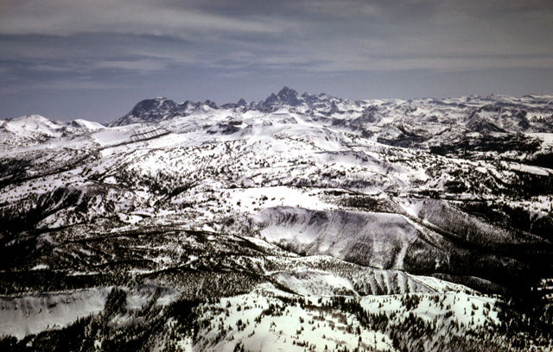
Tetons’ gentle western slope
Notes:
Now let’s have a look at geologic structure – the orientation and arrangement of rock units in 3D space. Notice the Tetons’ gentle western slope …

Slide 23
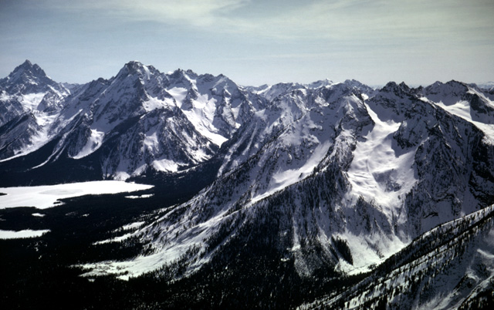
Tetons’ steep eastern slope
Notes:
… and much steeper eastern slope.

Slide 24
Teton Fault
Notes:
This arrangement is due to displacement along a major normal fault know as the Teton Fault.

Slide 25
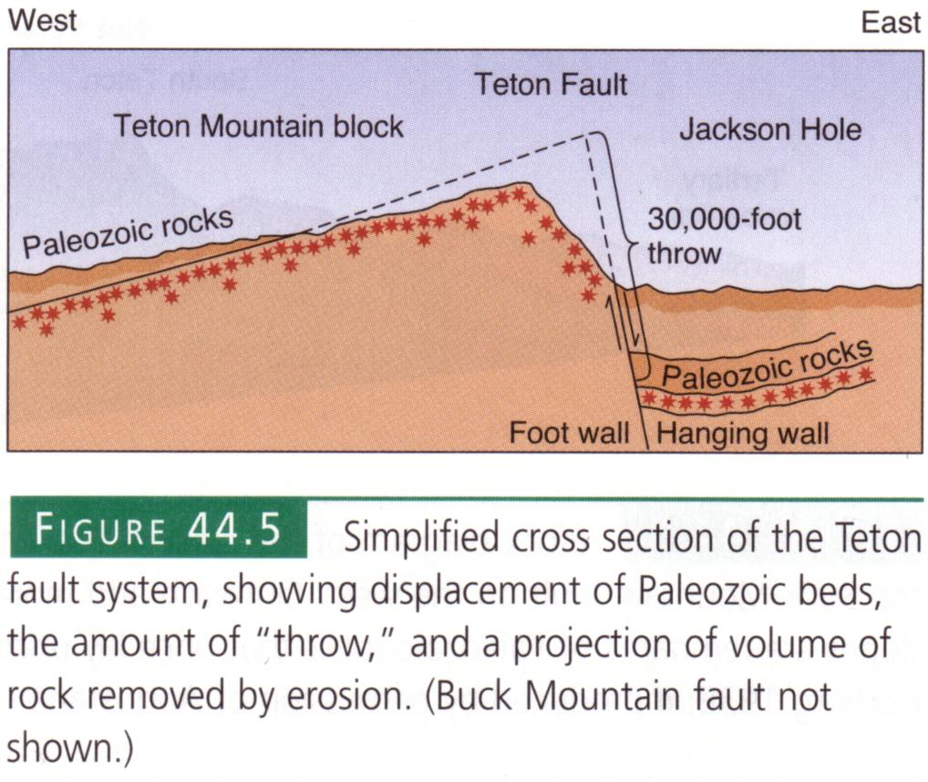
Notes:
By comparing the position of once-continuous Paleozoic rocks on either side of the Teton Fault, a whopping displacement of 30,000 feet is interpreted. That’s an enormous amount of uplift to take place over only the last 9 million years or so and amounts to an uplift rate of about 1 foot every 300-400 years.

Slide 26
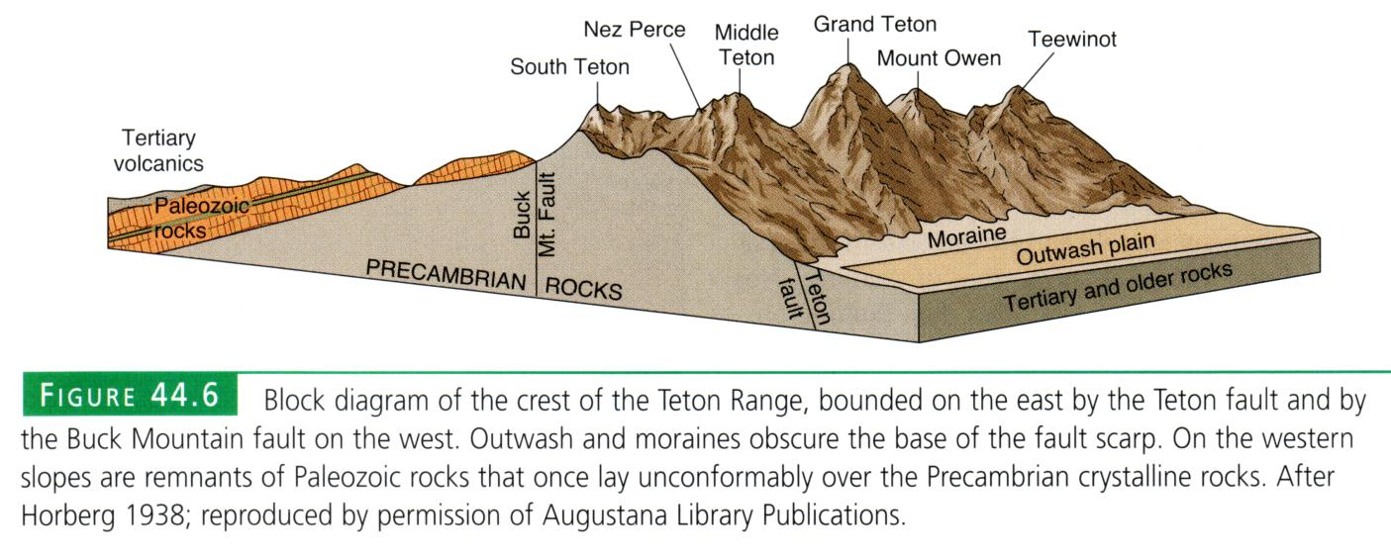
1938!
Notes:
Your book attributes the gentle tilt of the Paleozoic rocks to differential fault displacement, meaning that the throw on the Teton Fault was greater than on some unseen fault to the west of the range. Bear in mind that this interpretation is based upon work done in 1938!!!!!!

Slide 27
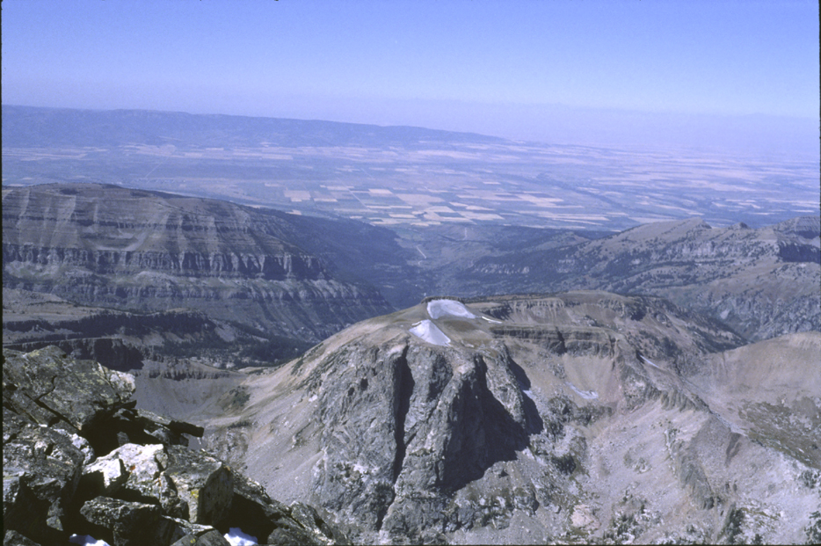
Differential uplift or rotation along curved normal faults?
Notes:
A more modern interpretation involves rotation along curved normal faults and …

Slide 28
Domino theory rotation
Notes:
… the domino-toppling effect discussed in the previous lesson.

Slide 29
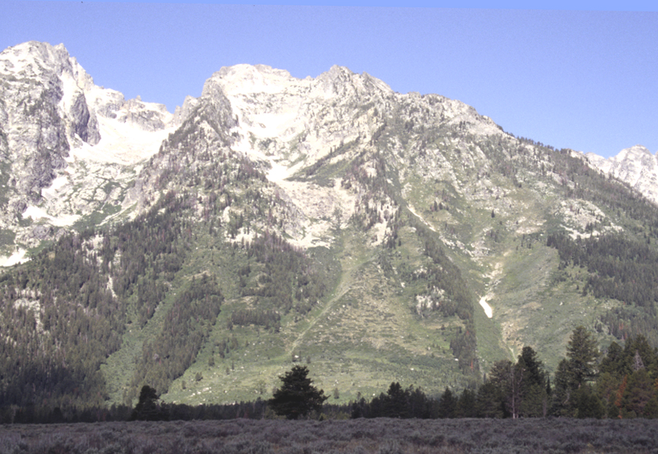
Teton Fault displacing alluvial fan
Notes:
Although the Teton Fault is buried by sediments in most places, in some places it cuts through the sediments and is easily seen on the surface.

Slide 30
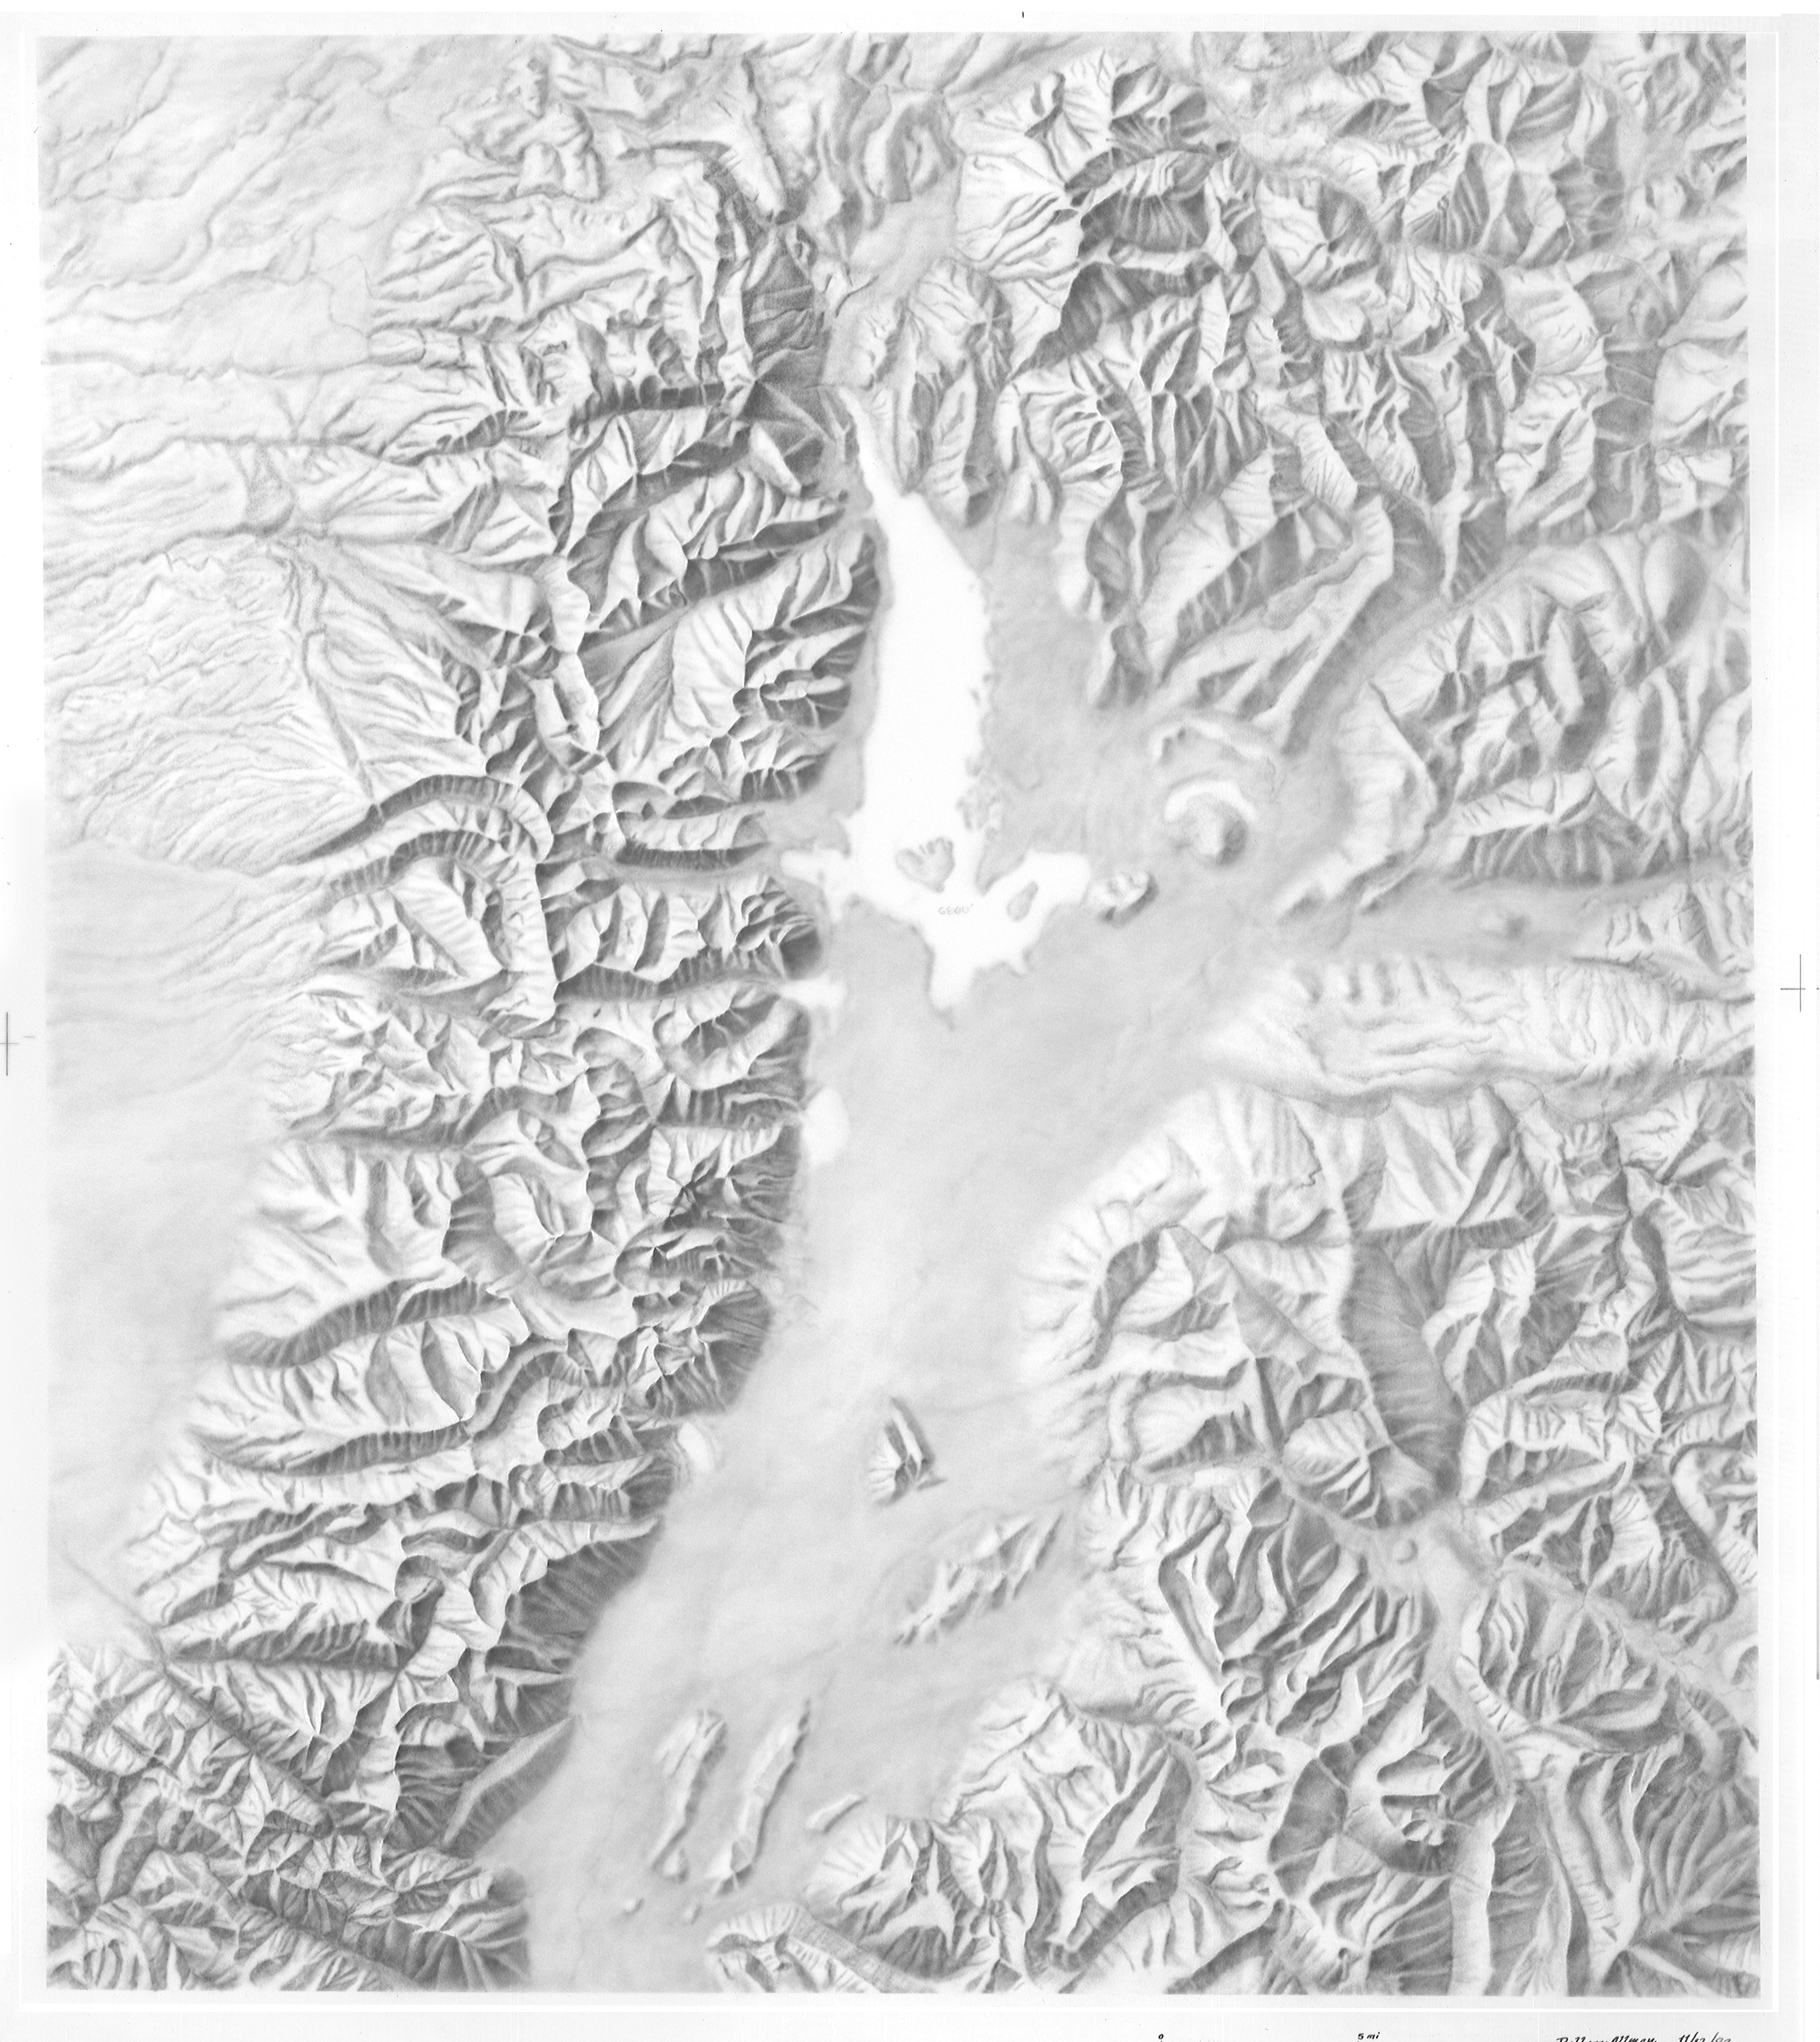
Notes:
It’s pretty easy to pick out the Teton Fault in this shaded relief map. Faults typically produce rather linear topographic features. There are other faults in the Tetons. Can you spot them?

Slide 31
Notes:
There’s a nice lineation here produced by faulting, but the most important fault, other than the Teton Fault, is….

Slide 32
Notes:
… here, and it’s called the Buck Mountain fault.

Slide 33
Notes:
The Buck Mountain Fault is a reverse fault – meaning that the block above the fault plane moves upwards, opposite to the pull of gravity. Such faults are typically produced by lateral compression, in this case associated with the early Cenozoic Laramide orogeny. You can see that the Buck Mountain Fault has lifted the Precambrian Rocks above the Paleozoic sedimentary rocks and contributes significantly to the overall relief of the central Tetons.

Slide 34
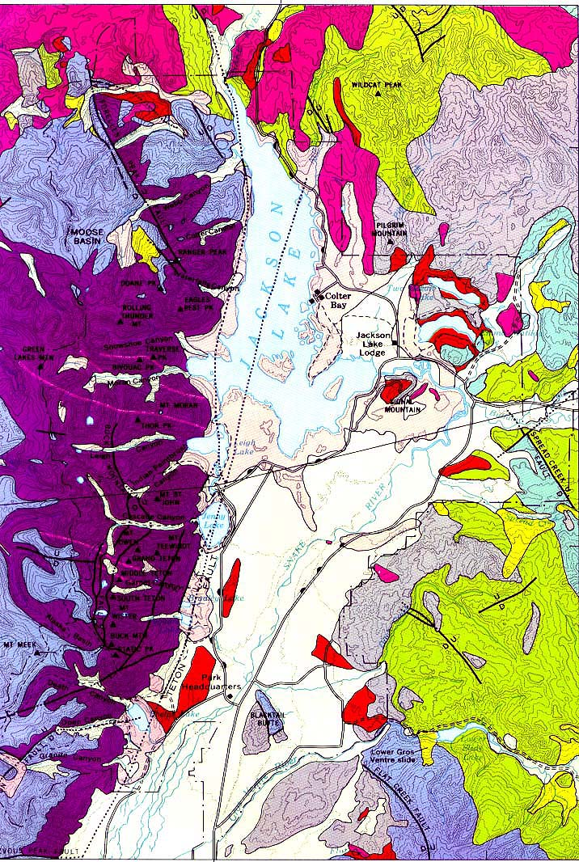
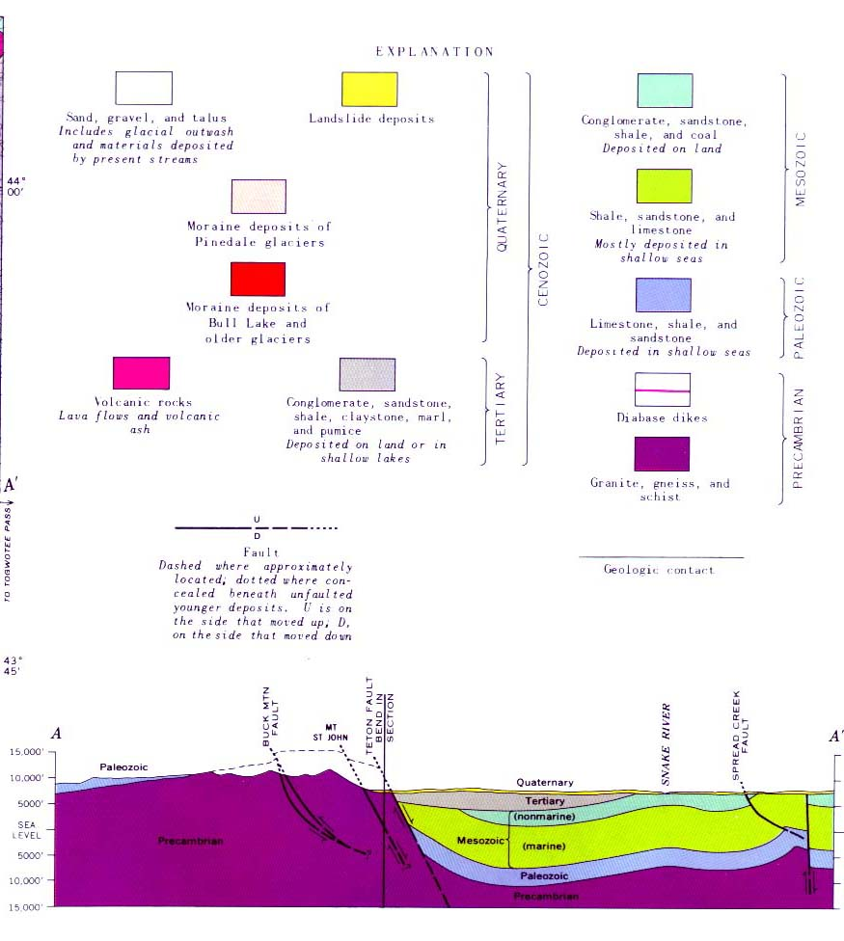
A’
A
Spread Creek Fault
A
A’
Notes:
There are other Laramide reverse faults in the area. The Spread Creek Fault is a good example of how compression affects the sedimentary rocks. Note in the cross section how the sedimentary rocks, because they are more flexible than the Precambrian metamorphic rocks, are folded near the fault.

Slide 35
Flat Creek Fault
Notes:
Much the same thing happened along the Flat Creek Fault, but with ultimately disastrous consequences.

Slide 36
Layers tilted toward river
Notes:
The problem started because the fold was oriented in such a way as to tilt the sedimentary rocks towards the Gros Ventre River.

Slide 37
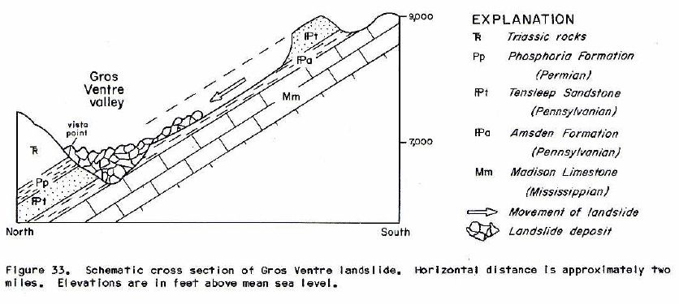
Notes:
By 1925 the river had eroded the base of these sedimentary rocks such that the tilted, water-saturated layers where left unsupported and the Gros Ventre landslide occurred. No one was injured in the actual slide,…

Slide 38
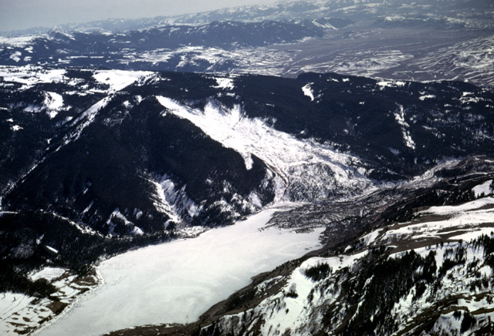
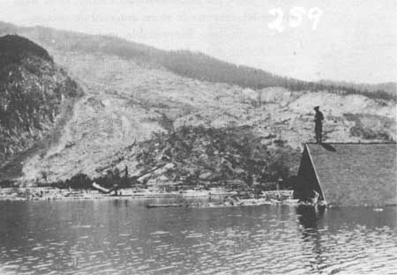
Gros Ventre Landslide and Lower Slide Lake
Notes:
… the debris flow blocked the valley and created Lower Slide Lake. Two years later, the debris dam gave way creating a flood that …

Slide 39
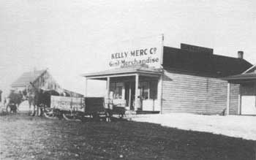
Notes:
… washed out the town of Kelly, WY – drowning six people.

